Slide 1

Département d’Informatique
Master Big Data Analytics And Smart System
Object tracking
&
Event detection
Réalisé par
Soufiyane Ouali
Mohamed outghratine
Encadré par:
Pr. Ahmed Azough

Slide 2
Plan :
01
Introduction
02
Object Detection
03
Object tracking & MOT
04
Conclusion

Slide 3

Introduction :
One of the most powerful and compelling types of AI is computer vision which you’ve almost surely experienced in any number of ways without even knowing. Here’s a look at what it is, how it works, and why it’s so awesome (and is only going to get better).
Computer vision is the field of computer science that focuses on replicating parts of the complexity of the human vision system and enabling computers to identify and process objects in images and videos in the same way that humans do. Until recently, computer vision only worked in limited capacity.

Slide 4
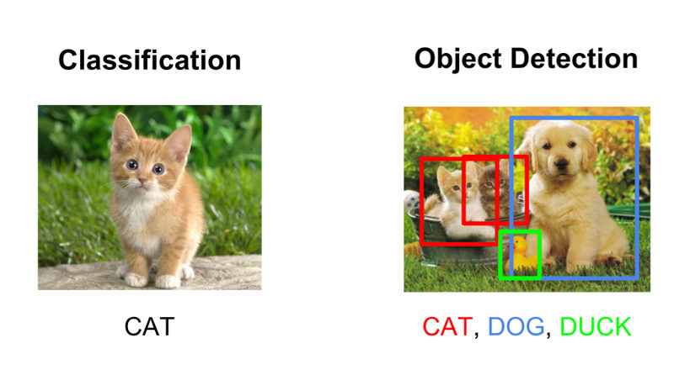
What is object detection?
Object detection is a computer vision technique that works to identify and locate objects within an image or video. Specifically, object detection draws bounding boxes around these detected objects, which allow us to locate where said objects are in (or how they move through) a given scene.
Object detection is commonly confused with image recognition, so before we proceed, it’s important that we clarify the distinctions between them.

Slide 5
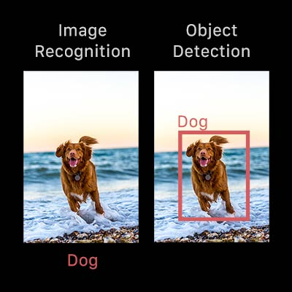
Object detection & image recognition ?
Image recognition assigns a label to an image. A picture of a dog receives the label “dog”. A picture of two dogs, still receives the label “dog”. Object detection, on the other hand, draws a box around each dog and labels the box “dog”. The model predicts where each object is and what label should be applied. In that way, object detection provides more information about an image than recognition.
Here’s an example of how this distinction looks in practice:

Slide 6
Why is object detection important?
Object detection is inextricably linked to other similar computer vision techniques like image recognition and image segmentation, in that it helps us understand and analyze scenes in images or video.
But there are important differences. Image recognition only outputs a class label for an identified object, and image segmentation creates a pixel-level understanding of a scene’s elements. What separates object detection from these other tasks is its unique ability to locate objects within an image or video. This then allows us to count and then track those objects.

Slide 7
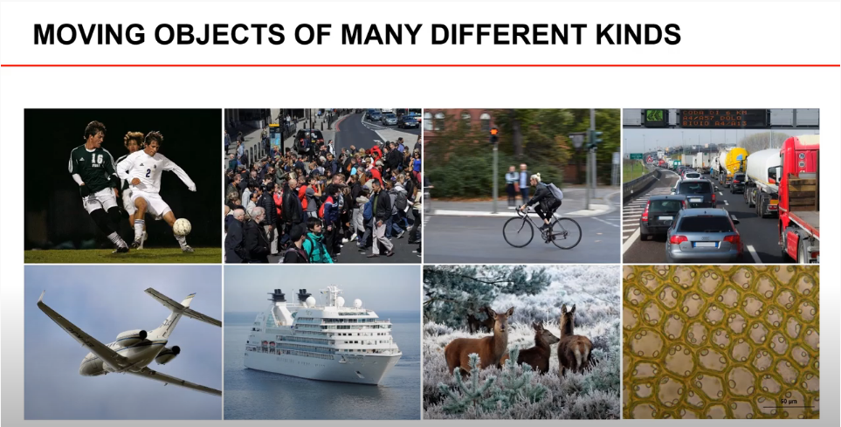
What is Object Tracking ?
Object tracking is a discipline within computer vision, which aims to track objects as they move across a series of video frames. Objects are often people , but may also be animals, vehicles or other objects of interest, such as the ball in a game of soccer.
Object tracking means estimating the state of the target object present in the scene from previous information.

Slide 8
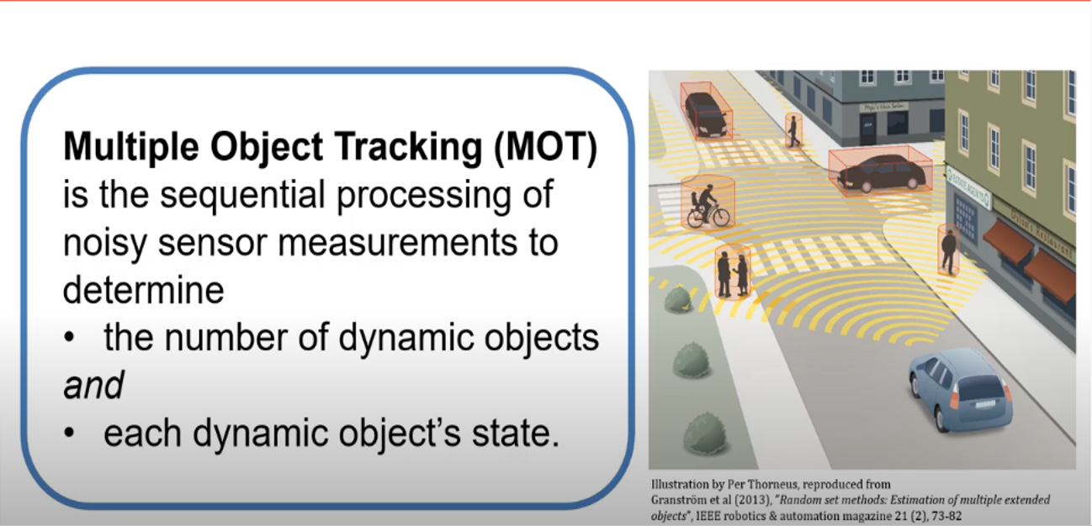
MOT ?
As the name suggests, multiple object tracking consists of keeping track of ob-jects in a video as they move around. A formal description would be: for each frame in a video , localize and identify all objects of interest, so that the identi-ties are consistent throughout the video. In other words, a good model has to accurately detect objects in each frame, and provide a consistent labelling of them.

Slide 9
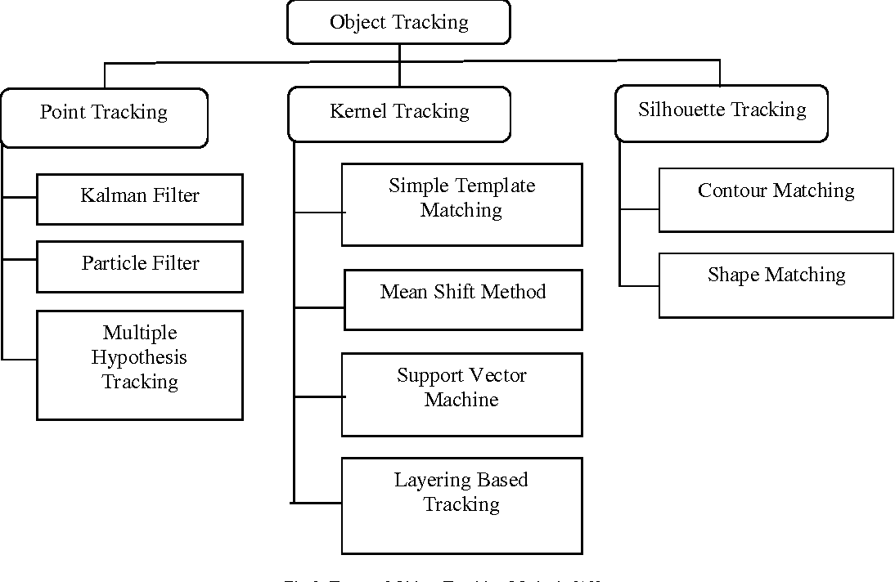
Object Tracking Methods
Tracking can be defined as the problem of approximating the path of an object in the image plane as it moves in a scene. The purpose of an object tracking is to generate the route for an object by finding its position in every single frame of the video . Object is tracked for object extraction, object recognition and decisions about activities. Object tracking can be classified as point based tracking, kernel based tracking and silhouette based tracking. For illustration, the point trackers involve detection in every frame; while geometric area or kernel based tracking or contours-based tracking require detection only when the object first appears in the scene . Tracking methods can be divided into following categories:

Slide 10
Point based Tracking
In an image structure, moving objects are represented by their feature points during tracking. Point tracking is a complex problem particularly in the inci-dence of occlusions, false object detections. Recognition can be done relatively simple, by thresholding for the identication of these points.
Point based tracking approaches are described below:
Kalman Filter : They are based on Optimal Recursive Data Processing Algorithm. The Kalman Filter performs the restrictive probability density prop-agation.
Particle Filter : The particle filter generates all the models for one variable before moving to the next variable. Algorithm has an advantage when variables are generated dynamically and there can be unboundedly numerous variables.
Multiple Hypothesis Tracking (MHT) : In MHT algorithm , several frames have been observed for better tracking outcomes MHT is an iterative algorithm.

Slide 11
Kernel Based Tracking
Kernel tracking is usually performed by the moving object, which is represented by a embryonic object region , from one frame to the next.
Kernel based approaches are described below:
Template Matching : Template matching is a brute force method of examining the Region of Interest in the video.
The matching procedure contains the image template for all possible positions in the source image and calculates a numerical index that species how well the model fits the picture at that position. This method is capable of dealing with tracking single image and partially occluded object.
Mean Shift Method : Mean-shift tracking tries to find the area of a video frame that is locally most similar to a
previously initialized model.
Support Vector Machine (SVM) : SVM is a broad classication method which is termed by a set of positive and negative sample values. It can handle single image, partial occlusion of object but necessity of physical initialization and training is must.
Layering based tracking : This is another method of kernel based tracking where multiple objects can be tracked. It can be capable of tracking multiple images and full occlusion of object.

Slide 12
Silhouette Based Tracking
Some object will have complex shape such as hand, fingers, shoulders that can-not be well defined by simple geometric shapes. Silhouette based methods afford an accurate shape description for the objects. The aim of a silhouette-based object tracking is to find the object region in every frame by means of an object model generated by the previous frames. This method is capable of dealing with variety of object shapes, Occlusion and object split and merges. Silhouette based tracking approaches are described below :
Contour Tracking : Contour tracking methods , iteratively progress a primary contour in the previous frame to its new position in the current frame .Contour Tracking can be performed using two different approaches. The first approach uses state space models to model the contour shape and motion. The second approach directly evolves the contour by minimizing the contour energy using direct minimization techniques such as gradient descent. The most significant advantage of silhouettes tracking is their flexibility to handle a large variety of object shapes.
Shape Matching : These approaches examine the object model in the existing frame. Shape matching performance is similar to the template based tracking in kernel approach. Another approach to Shape matching is to find matching silhouettes detected in two successive frames. Silhouette matching, can be considered similar to point matching.

Slide 13
Conclusion
Signicant progress has been made in object tracking during the last few years. Several robust trackers have been developed which can track objects in real time in simple scenarios.
Object tracking can be performed using various methods based on point, kernel, and silhouette. Advance study may be carried out to find efficient algorithm to reduce computational cost and to decrease the time required for tracking the object for variety of videos containing diversied characteristics.

Slide 14
Thanks for your attention

